Slide 1


Proposal to build Enclosures Finder Solution for Altech.
By Elmehdi AitBrahim
Software Developer / Owner of Code Gate October 2016

Slide 2

BACKGROUND
A few years ago Altech wanted to put in place an Enclosure Finder App such as the product finder of Spelsberg: https://www.spelsberg.co.uk/product-finder/
An estimation quote has been provided to Altech and since then the project was on hold.
Altech prepared and structured the data related to the enclosures in a spreadsheet based on an existing PDF catalog.
Recently the project is revived and a review of the old estimate was requested.
The current proposal from Code Gate for the prospective project provides a new estimates based on the new parameters of collaboration with Altech.
Code Gate is an offshore tech company based on Casablanca, Morocco and specialized in Software Development.

Slide 3

Solution and Engagement Approach

Slide 4
OUR APPROACH
Code Gate has derived Altech Enclosures Finder Solution feature list based upon the following sources:
The meetings’ notes conducted in the past with Michael Cooper and Jeff Roye
The sample sites that provide the same functionality:
https://www.spelsberg.co.uk/product-finder/
http://www.budind.com/product-selector.php
The Excel spreadsheet named “AltechEnclosureFinder.xlsx”
The picture of the desired Enclosures Finder Web App:

Slide 5
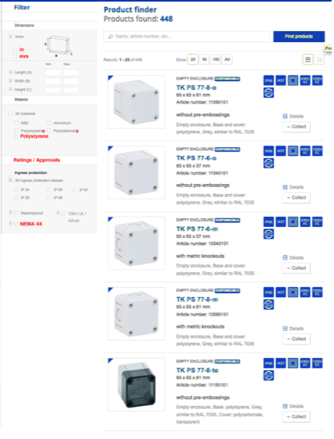
OUR APPROACH

Slide 6
OUR APPROACH
Inline with Altech objectives, the Enclosures Finder Solution will consist of 3 components:
Enclosures Finder Web App allows to list, find, filter, and see details of the enclosures.
Enclosures repository feeder program seeds and update the Enclosures’ database with data from
“AltechEnclosureFinder.xlsx”,
location of images,
Location of PDF,
Location of drawings,
Location of model
Enclosures and part numbers integration service maps each enclosure with a part number in order to get the stock.
Code Gate also provides a timeline and a budgetary estimate for implementing the Enclosures Finder Solution.

Slide 7
Components
Altech Enclosures Finder Solution features and functionality is divided into the following 3 components:
Enclosures Finder Web App
List Enclosures
Filter Enclosures
Enclosures and part numbers integration service
Map enclosure with part number
Find Enclosure
Enclosures repository feeder program
Data reader from Excel
Data reader from directories
Repository seeds from data readers
Detail of enclosure

Slide 8
FEATURE LIST – Enclosures Finder Web App
R1 | List Enclosures | List of enclosures with pagination. Each item of the enclosures list displays: Small picture* of the enclosure. Title of the enclosure. Dimensions of the enclosure. Material of the enclosure. IP Protection of the enclosure. Outdoor Use of the enclosure. UL Approval of the enclosure. NEMA 4X of the enclosure. Type of the enclosure. Part Number of the enclosure. Description of the enclosure.
R2 | Find Enclosure | Text box to type a searchable word about an enclosure. The searchable word could be: Title of the enclosure. Part number of the enclosure.
R3 | Filter Enclosures | Filter enclosures by the following criteria:
* Provide small & big picture for each enclosure

Slide 9
FEATURE LIST – Enclosures Finder Web App
R3 | Filter Enclosure | Material: Polycarbonate, etc. (List of material is needed) Dimensions: Length (in and mm), Width (in and mm), and Depth (in and mm) Type: (List of type is needed). IP Protection: IP55, etc. (List of IP Protection is needed) Outdoor Use: Yes or No. UL Approval: Yes or No. NEMA 4X: Yes or No.
R4 | Detail of Enclosure | Display the following enclosure’s data: Big picture* of the enclosure. 8. NEMA 4X of the enclosure. Title of the enclosure. 9. Type of the enclosure. Dimensions of the enclosure. 10. Part Number of the enclosure. Material of the enclosure. 11. Description of the enclosure. IP Protection of the enclosure. 12. Link to drawing of the enclosure. Outdoor Use of the enclosure. 13. Link to model of the enclosure. UL Approval of the enclosure. 14. Link to PDF of the enclosure
* Provide small & big picture for each enclosure

Slide 10
FEATURE LIST – Enclosures repository feeder program
R5 | Data reader from Excel | Read data from “AltechEnclosureFinder.xlsx” “AltechEnclosureFinder.xlsx” has the following columns in this order: Length (in) 10. Outdoor Use Width (in) 11. UL approval Depth (in) 12. NEMA 4X Length (mm) 13. Type Width (mm) 14. Part Number Depth (mm) 15. Description Material 16. Image IP Protection 17. PDF Link Drawing 18. Model
R6 | Data reader from directories | Read image, PDF, drawing, model files provided in “AltechEnclosureFinder.xlsx” directly from their directories' location.
R7 | Repository seeds from data readers | Seeds the read data into the Enclosure’s repository for the first time of use. After the seed, a smart synchronization occurs to write the delta from the modified “AltechEnclosureFinder.xlsx” into the repository.

Slide 11
FEATURE LIST – Enclosures and part numbers integration service
R8 | Map enclosure with part number | Fetch the enclosure’s stock based on its part number. Where to display the enclosure’s stock? Or just link from the enclosure to the cross reference search: http://www.altechcorp.com/search/

Slide 12
PROPOSED TECHNOLOGY STACK
Programming Language | C# and JavaScript
Stuck Technology | AngularJS, ASP Web API and Entity Framework
Database | SQL Server
Host | Web.com
URL | http://www.altechcorp.com/EnclosuresFinder
12

Slide 13

Time and Budgetary Estimate

Slide 14
TIME EFFORT ESTIMATES
Project Activities | Efforts in Person Hours
Analyzing requirements | 6.00
Enclosures Finder Web App development | 40.00
Enclosures repository feeder program development | 24.00
Enclosures and part numbers integration service development | 2.00
Testing and Validation | 16.00
Project Management / Meetings | 4.00
Total Efforts ( Person Hours ) | 92.00

Slide 15
BUDGETARY ESTIMATES
Project Activities | Total Time | Cost per H | Total Cost
Altech Enclosures Finder Solution | 92.00 H | $70.00 / H | $6,440.00
Maintenance support | 1 Year | $0.00 / H | $ 0.00
Total Cost |  |  | $6,440.00

Slide 16
THANK YOU
Code Gate | 2016

